Slide 1

Lecture
on
“Advanced Computer Architecture –TCS 704”
by
Akansha Gupta
DEPARTMENT OF COMPUTER SCIENCE AND ENGINEERING
GRAPHIC ERA DEEMED TO BE UNIVERSITY – 248002

Slide 2
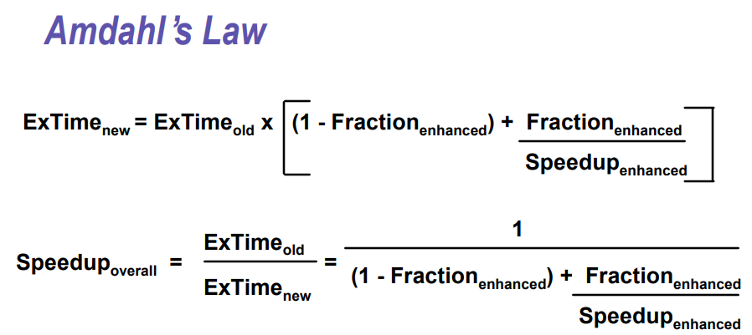

Slide 3
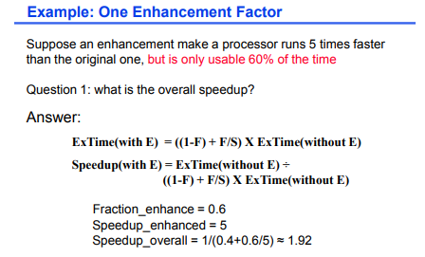

Slide 4
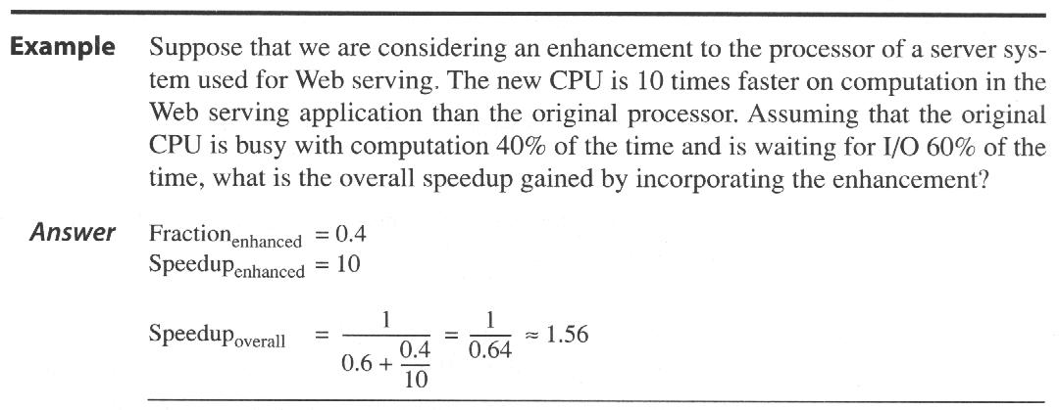

Slide 5
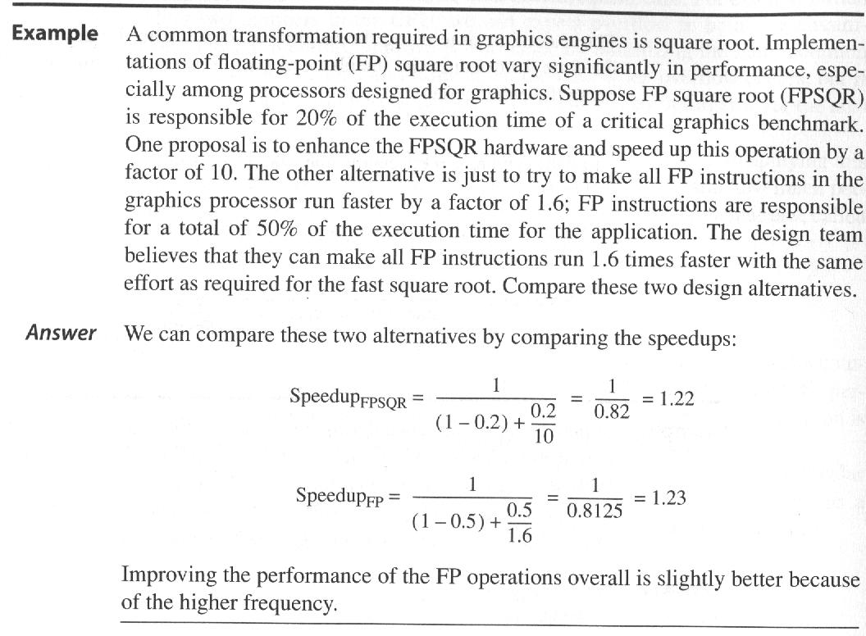

Slide 6
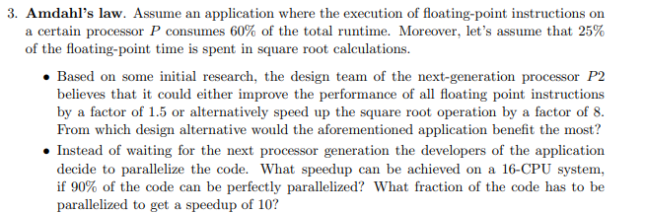

Slide 7
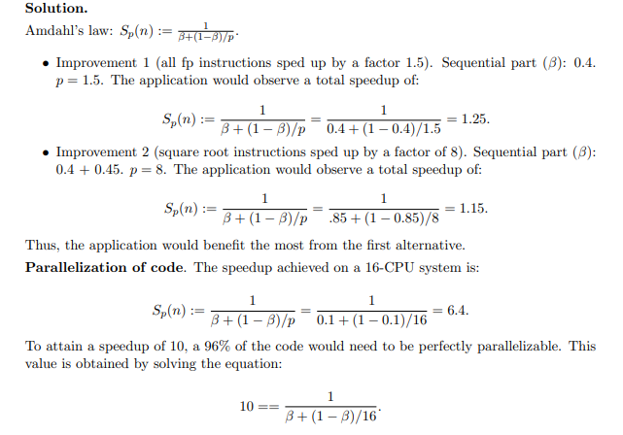

Slide 8
Benchmarks
The real applications are the best choice of benchmarks to evaluate the performance (Ex. MSWord, Excel, Photoshop,...)
The workloads will not be known at the time of evaluation. Hence, the benchmark program which resemble the real applications are chosen.
The three types of benchmarks are:
a. KERNELS: which are small, key pieces of real applications e.g., Livermore loops, linpack;
b.Toy Programs: which are 100 line programs from beginning programming assignments, e.g.,: sieve, puzzle, quicksort,
c. Synthetic Benchmarks: Fake programs invented to try to match the profile and behavior of real applications e.g., Whetstone, dhrystone.
Need industry standards so that different processors can be fairly compared
Companies exist that create these benchmarks: “typical” code used to evaluate systems

Slide 9
BENCHMARK SUITES
SPEC - Standard Performance Evaluation Corporation (www.spec.org)
SPEC was created to improve the measurement and reporting of CPU performance, through a better controlled measurement process and the use of more realistic benchmarks.
– originally focusing on CPU performance SPEC89|92|95, SPEC CPU2000 (11 Int + 13 FP)
– graphics benchmarks: SPECviewperf, SPECapc
– server benchmark: SPECSFS, SPECWEB
• PC benchmarks (Winbench 99, Business Winstone 99, High-end Winstone 99, CC Winstone 99) (www.zdnet.com/etestinglabs/filters/benchmarks)
• Transaction processing benchmarks (www.tpc.org)
• Embedded benchmarks (www.eembc.org)

Slide 10
Locality Of References
This important fundamental observation comes from properties of programs. The most important program property that we regularly exploit is locality of references : Programs tend to reuse data and instructions they have used recently.
90/10 rule comes from empirical observation: "A program spends 90% of its time in 10% of its code"
An implication of locality is that we can predict with reasonable accuracy what instructions and data a program will use in the near future based on its accesses in the recent past.
Two different types of locality have been observed:
Temporal locality: states that recently accessed items are likely to be accessed in the near future.
Spatial locality: says that items whose addresses are near one another tend to be referenced close together in time.

Slide 11
Taking Advantage of Locality
Memory hierarchy
Store everything on disk
Copy recently accessed (and nearby) items from disk to smaller DRAM memory
Main memory
Copy more recently accessed (and nearby) items from DRAM to smaller SRAM memory Main memory
Cache memory attached to CPU

Slide 12
To Take Advantage of Locality
Employ memory hierarchy
Use multiple levels of memories
‘Larger’ distance from processor =>
larger size
larger access time

Slide 13
https://youtu.be/dH19ZRo022k
THANKS

